Slide 1
Condition for causality in Z domain
Condition for stability in Z domain, Inverse Z transform-Power series expansion

Slide 2
Causality of DT Systems
An linear time invariant discrete time system is said to be causal if the impulse response h[n] = 0 for n< 0 and it is therefore right-sided.
The ROC of such a system H[z] is the exterior of a circle.
If H[z] is rational then the system is said to be causal if the ROC lies exterior of the circle passing through the outermost pole and includes infinity area.
A DT system which is linear time invariant with its system function H [z] rational is said to be causal iff the ROC is the exterior of a circle which passes through the outermost pole of H[z].
Further, the degree of the numerator polynomial of H[z] should be less than or equal to the degree of the denominator polynomial.

Slide 3



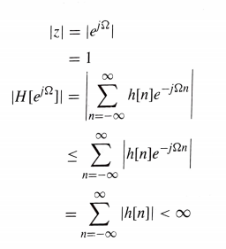
Stability of DT System
An LTI discrete time system is said to be BIBO stable if the impulse response h[n] is summable.
This is expressed as
.........(1)
The corresponding requirement on H[z] is that the ROC of H[z]contains unit circle.
By definition of z-transform
.........(2)

Slide 4
Stability of DT System
From Equation (1) we see that the stability condition given by Equation (2) is satisfied if , Thus implies that H [z] must contain unit circle |z| = 1.
An LTI system is stable iff the ROC of its system function H[z] contains the unit circle lzl = 1.

Slide 5
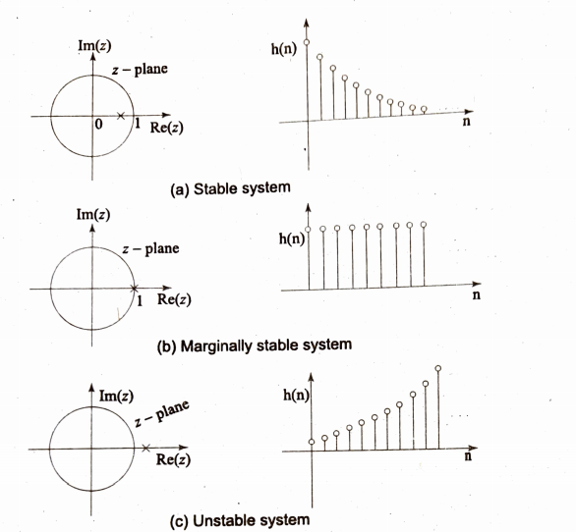
Relationship between the stability of a system and the location of poles.

Slide 6
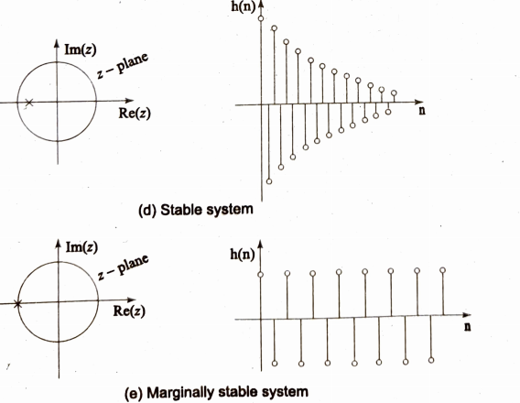

Slide 7
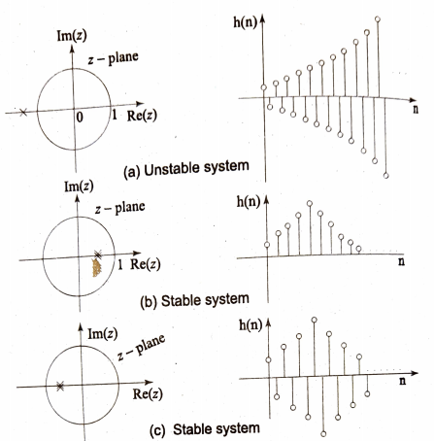

Slide 8
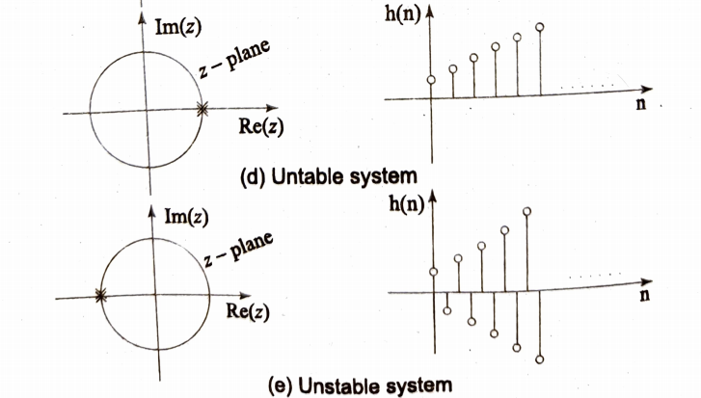

Slide 9
Causality and Stability of DT System
For a causal system whose H[z] is rational the ROC is outside the
outermost pole.
For the BIBO stability the ROC should include the unit circle
lzl = l.
An LTI Discrete system with the system function H[z] is said to
be both causal and stable if all the poles of H[z] lie inside the unit
circle.

Slide 10
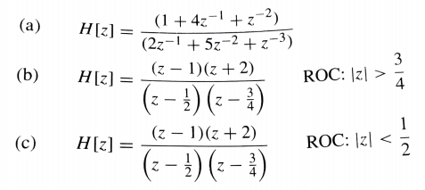
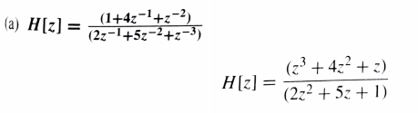
Example:1
Consider the following system functions:
Determine whether these systems are causal or not.
Solution:
H[z] is irrational since the degree of the numerator polynomial is greater than the denominator polynomial.
The System is Non-causal.

Slide 11


b)
The ROC is the exterior of the circle passing through the outermost pole of H[z]. Hence h[n], the impulse response is right-sided.
The System is Causal.
The ROC is the interior of the circle passing through the innermost pole of H[z]. Hence h[n], the impulse response is left-sided.
The System is Non-causal.

Slide 12
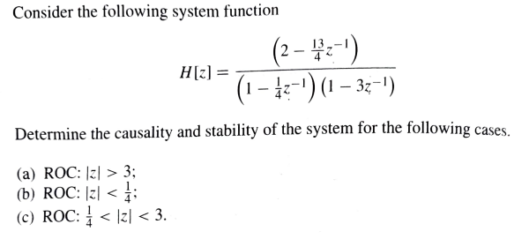
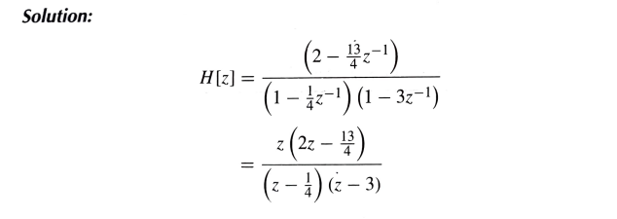
Example:2

Slide 13
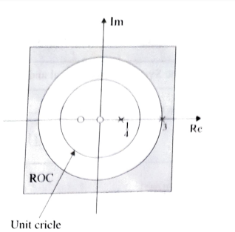
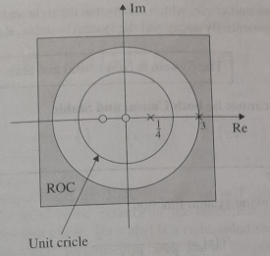
a) ROC: |z| > 3
The ROC is the exterior of the circle passing through the outermost pole of H[z] which is rational (the denominator and numerator polynomials have same order).
The impulse response h[n] is a right-sided sequence. Hence H[z] is causal.
The ROC does not contain unit circle. Hence h[n] is not summable The system is unstable. Refer to Figure 1(a).
The System is Causal and Unstable
Figure 1 (a)

Slide 14
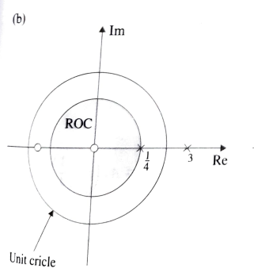
(b) ROC: |z| <1/4
The ROC is the interior of the circle passing through the innermost pole of H[z].
The impulse response is a left-sided sequence. H[z] is therefore non- -causal.
The ROC does not include the unit circle. The h[n] is growing exponential negative sequence. The system is unstable. Refer to Figure 1(b).
The System is Non-causal and Unstable
ROC
Figure 1 (b)

Slide 15
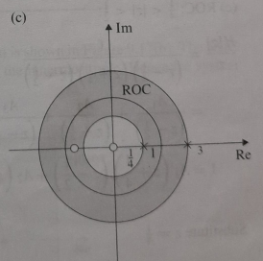
(c) ROC: ¼ < |z| < 3
The ROC is to the left of the outermost pole and to the right innermost pole. Hence h[n] will have right and left-sided sequences, which is non-causal.
The ROC includes unit circle, which means that the right and left side sequence of h[n] will exponentially decay and the system is stable. Refer to Figure 1(c).
The System is Non-causal and Stable
Figure 1 (c)

Slide 16

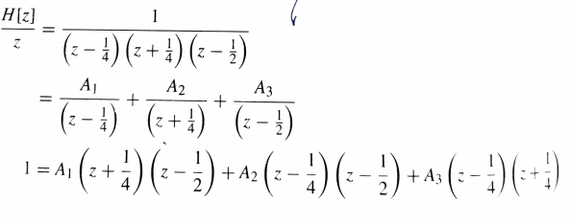
Example:3
Consider the following system function
For different possible ROCs, determine the causality and impulse response of the system.
Solution:
The possible ROCs for H[z] to exist are (a) ROC: |z|>1/2 (b) ROC: |z|<1/4 and (c) ROC: ¼ < |z|< 1/2.

Slide 17
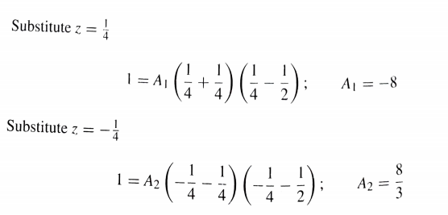
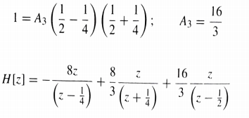
Substitute z=1/2

Slide 18
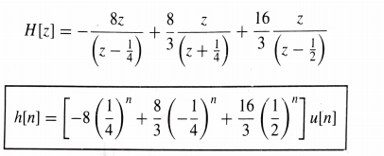
ROC: |z| >1/2
The pole-zero diagram and the ROC are shown in Figure 1(a).
From Figure 1(a) the ROC is the exterior of the outermost pole z =1/2
Further, ROC includes unit circle.
Thus h[n] is a right-sided sequence and hence H[z] is causal. Since ROC includes unit circle and all the poles are within unit circle, the system is stable.

Slide 19
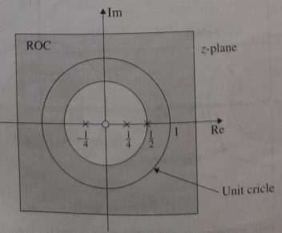
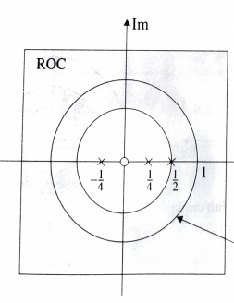
Z-plane
Re
Unit circle
Figure 1(a) Pole zero diagram and ROC: |z| >1/2
The System is Causal and Stable

Slide 20
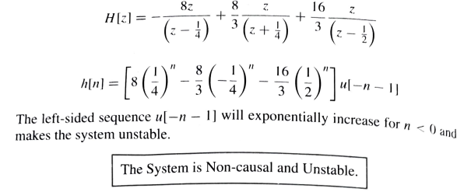
(b) ROC: |z| < ¼
For ROC: |z| <1/4 , the pole zero diagram is shown in Figure 1(b).
The ROC is interior of the circle passing through the innermost pole. Hence the system is non-causal. The condition that the ROC does not include unit circle implies that the system is unstable. The sequence h[n] is left-sided. This is obtained as follows.

Slide 21
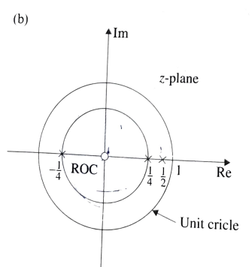
ROC
Figure 1(b) Pole zero diagram and ROC: |z| < 1/4
The System is Non-causal and Unstable

Slide 22
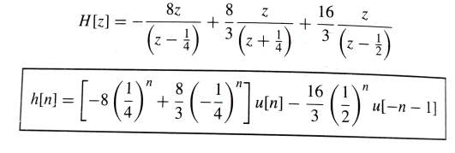
ROC: ¼ |z| < 1/2
The pole-zero diagram and ROC of H[z] are shown in Figure 1 (c) .
The ROC is concentric ring for ¼ |z| < 1/2
The h[n] sequences die to the poles at z = 1/4 and z=-1/4 are right-sided and the sequence due to the pole z =1/2 is left-sided.
Hence the system is non-causal. The ROC does not include the unit circle and hence the system is unstable.
The impulse response obtained as follows.

Slide 23
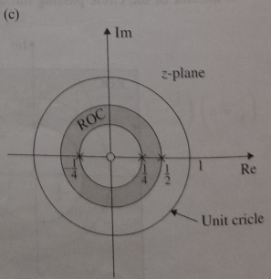
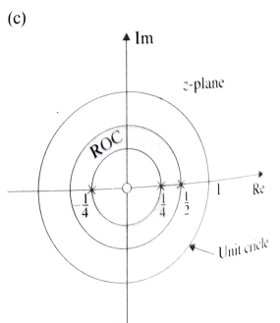
Figure 1(c) Pole zero diagram and ROC: ¼ |z| < 1/2
The System is Non-causal and Unstable

